Slide 1

Abdurehman Asfaw 448665
Ayyub Orujzade 466757
Bhupender Bhupender 466758

Slide 2

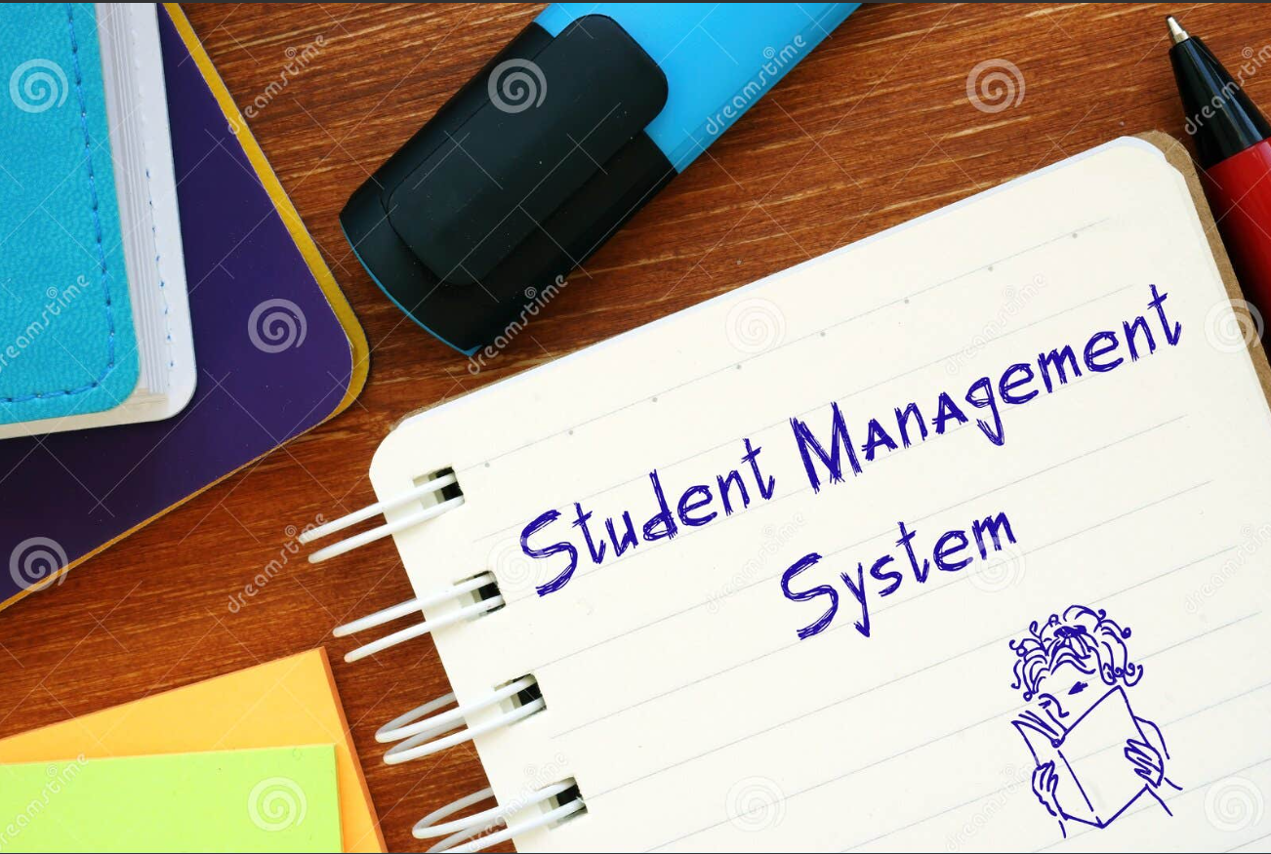
This student management system project focuses on creating a user-friendly and secure computer system for managing students, designed for long-term usability and scalability to accommodate the growing needs of educational institutions. The primary objective is to organize information effectively to minimize mistakes and ensure quick and easy access to data, enhance collaboration among students to improve their learning experience.

Slide 3
Project Overview
Objective
Key features
The Student Management System project aims to create an interactive web application to streamline student record management in educational institutions. It simplifies data entry, storage, and retrieval of student information, providing a user-friendly interface for administrators, faculty, and students.
Secure User
Automated Record-Keeping
Real-Time Updates and
Data Analysis and
Generation of Detailed
Easy Data Export in CSV.

Slide 4
Tools Used
Web Framework
Shinythemes
Shiny: interactive web applications directly from R user interface and server logic
Provides pre-made themes for Shiny applications. without the need for extensive CSS knowledge
Enhances the visual appeal and user interface of the application.
Changes the styling and appearance of the entire Shiny app with a single theme selection.
Shiny BS
Shiny BS
Provides additional Bootstrap components for Shiny.
Used for creating modal dialogs and other interactive UI components.
Facilitates the creation of dynamic and responsive user interfaces
Adds specific interactive Bootstrap elements to enhance user interaction within the Shiny app

Slide 5
Cont …
RMariaDB
Database
R interface for MariaDB databases
Establish a connection to the MariaDB Database
Facilitates database operations like querying and data manipulation (Fetching, inserting, updating and deleting)
MariaDB

Slide 6
Cont …
Rcpp
Digest
Integrates R with C++.(Used to Add Download CSV ).
Efficient Code than usual R code.
Better For Computational Tasks.
Creates cryptographic hash functions.
Used for securely storing passwords by hashing them before saving to the database.
DT
Lubridate
An R interface to the DataTables JavaScript library.
Used for rendering interactive data tables within the Shiny application.
Facilitates working with dates and times in R.
Used for managing date-time operations within the application
Dplyr
Vectorization for manipulating the database.
Before : Iterating through each row to add “EDIT & DELETE” Button. After: Vectorized code uses Dplyr:Mutate func. To add to dataframe at once

Slide 7
Cont …
R6
Used for defining database management classes with encapsulated methods for database operations.
Database manipulation : initialize , Fetching, adding, deleting, updating data
more intuitive and efficient handling of objects, especially in complex data manipulation tasks.
More efficient than S3 and S4 for large datasets or complex objects
Interoperability:
can be used along side S3 and S4

Slide 8
Cont …
S4
Devtools and usethis
For define the structure for students details
For Clear definitions of attributes and their types
Along with validation methods
Internal validity (type checking)
Roxygen2 : to document
Mploty : Named After Our Professor
Our package : to wrangle and draw a graph (ggplot2)

Slide 9
Future Enhancements
Enhancing the user interface and experience
Adding more detailed analytics
like Grading systems

Slide 10
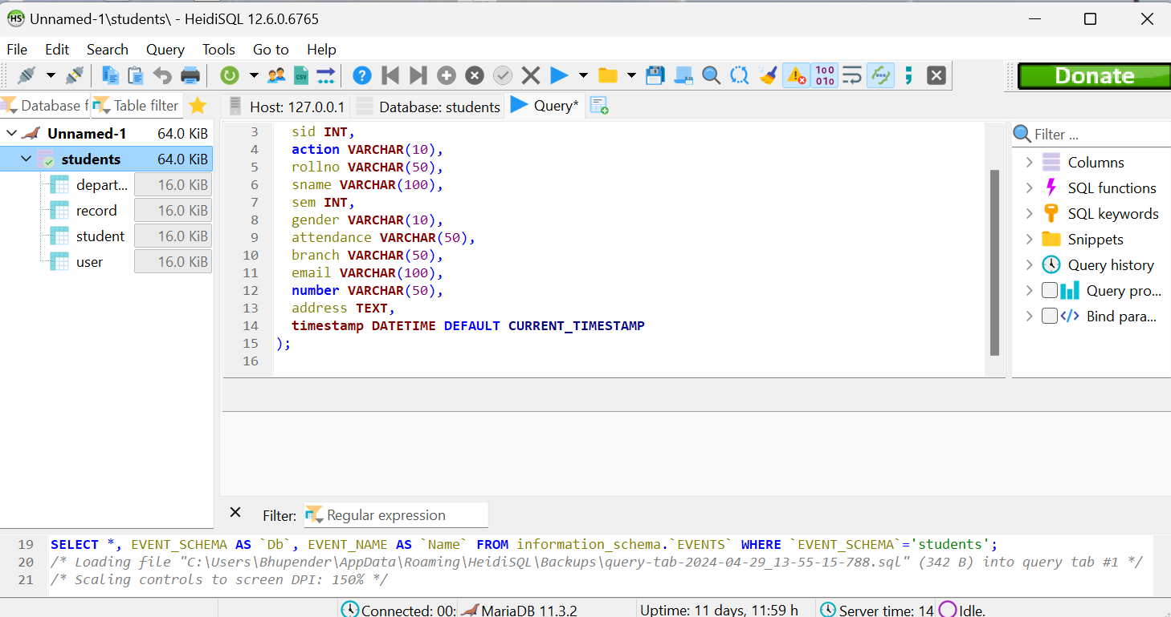
Database : MariaDB
(compatible with MySql)
Tables:
student
department
user
record
Libraries used:
DBI (interface between R and RDB)
RMariaDB:
Library ( RMariaDB )
Databse interface and MySql/MariaDB driver for R, allowing connections to MariaDB and MySql databasees.
Database Name: ‘students’

Slide 11
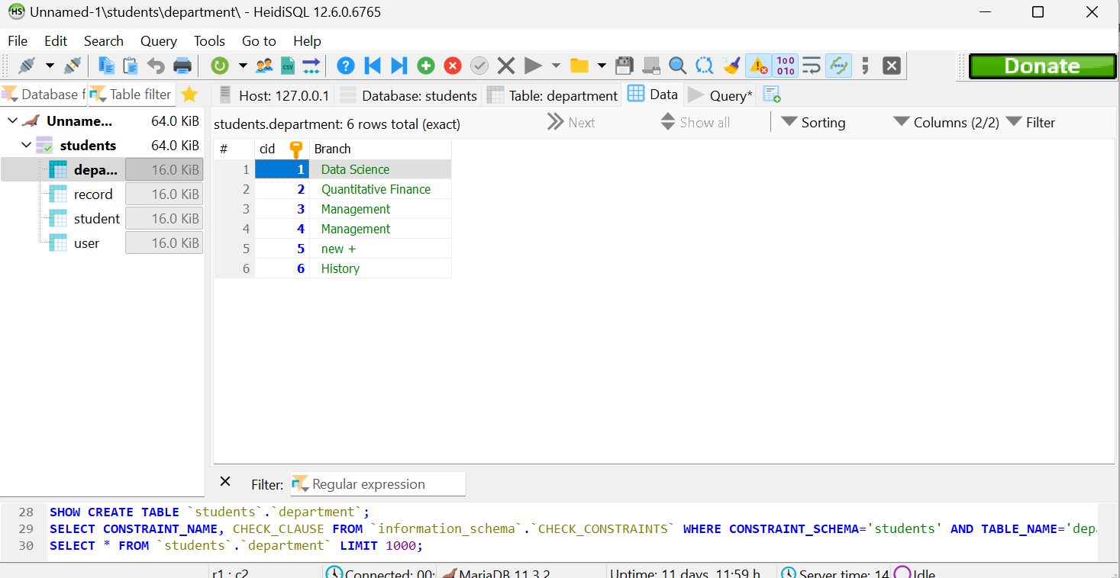
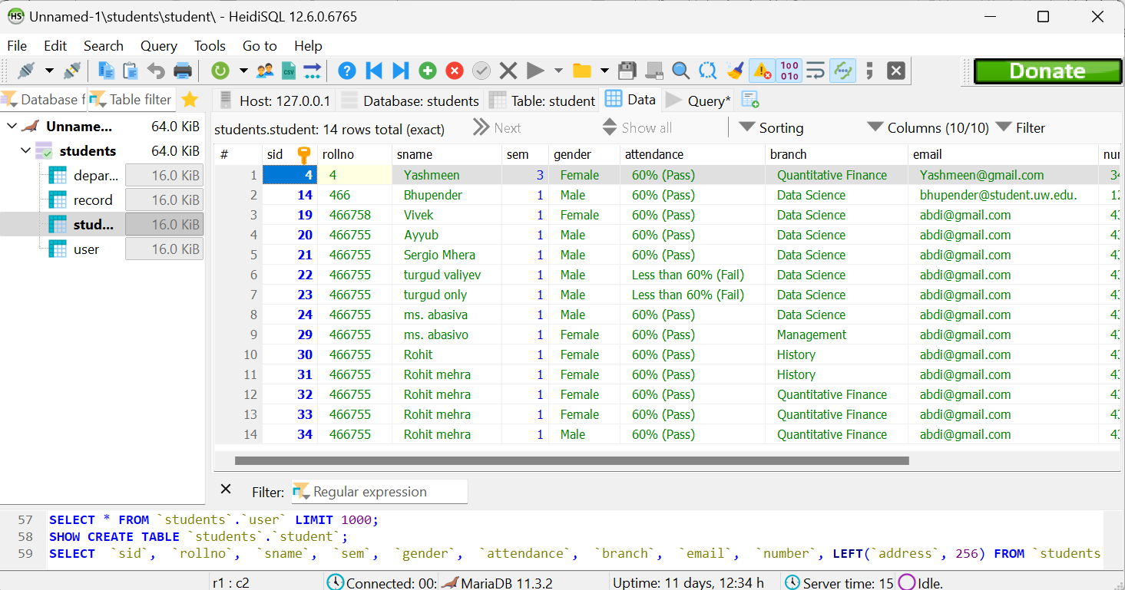
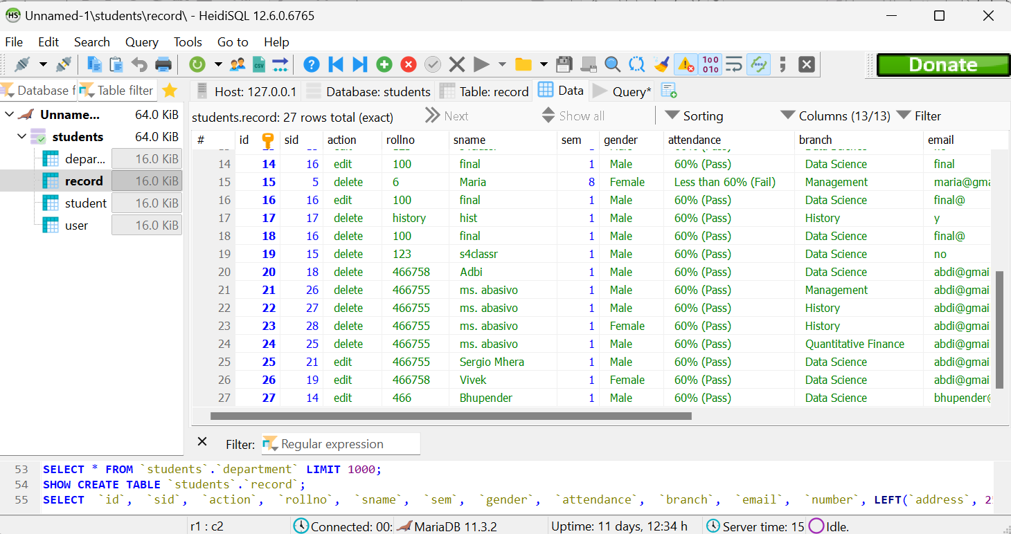
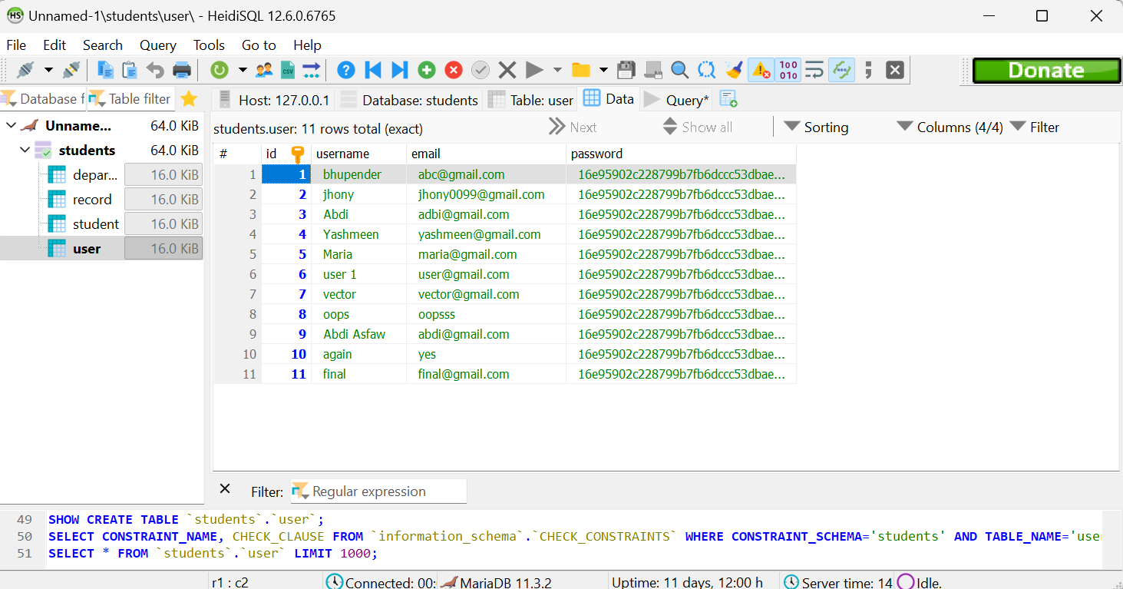

Slide 12
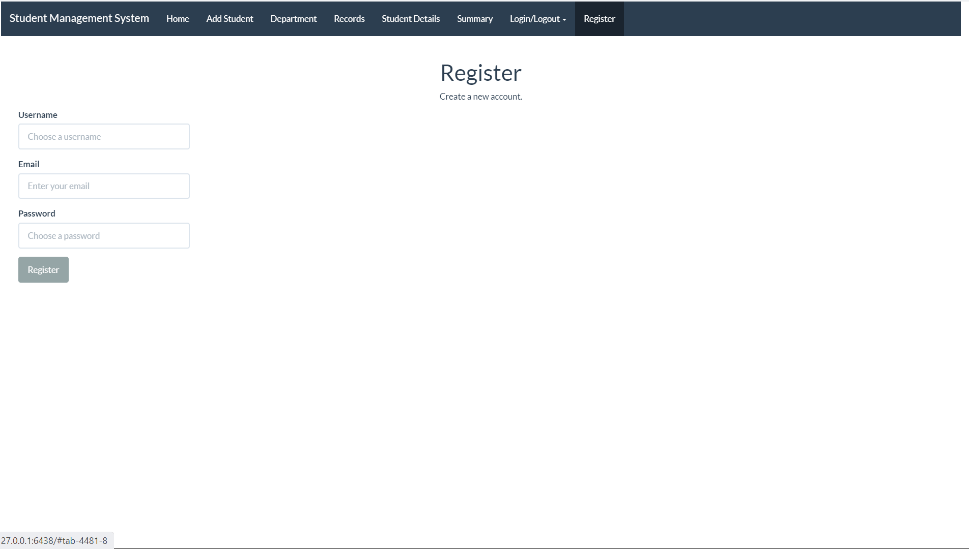
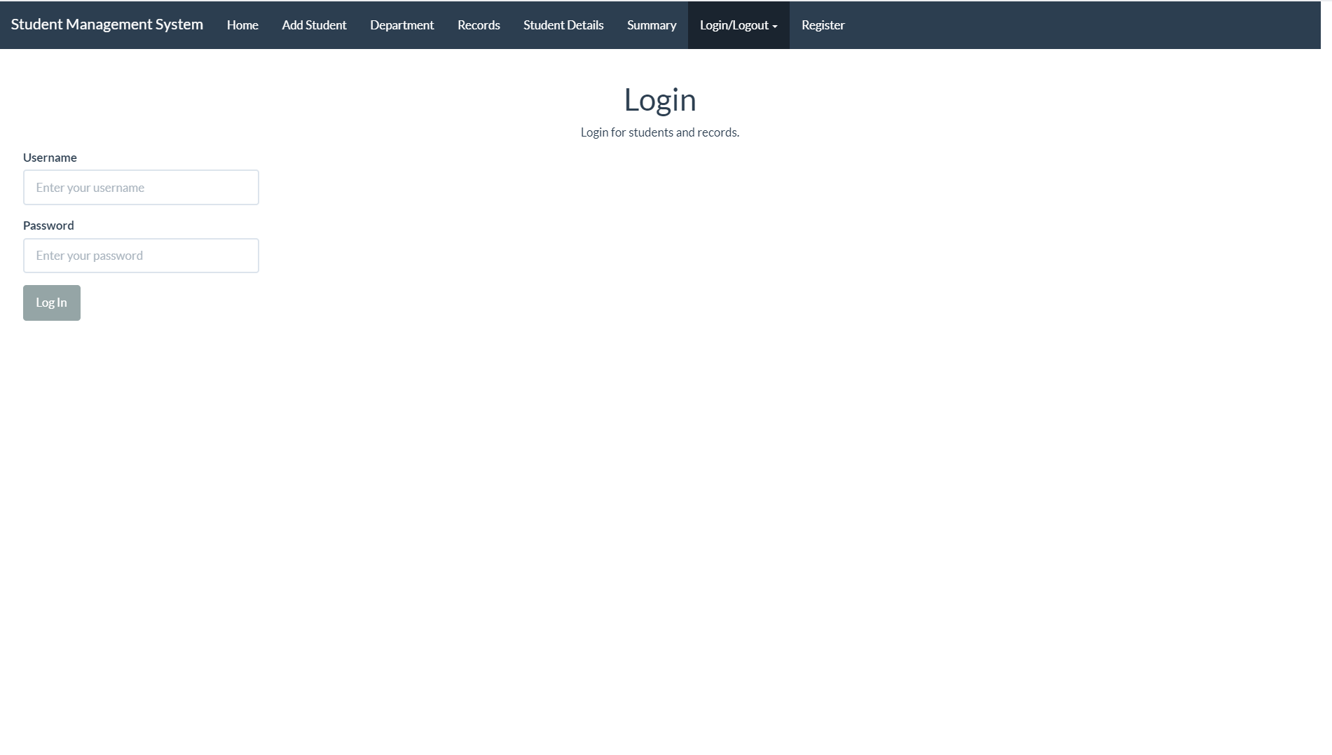

Slide 13
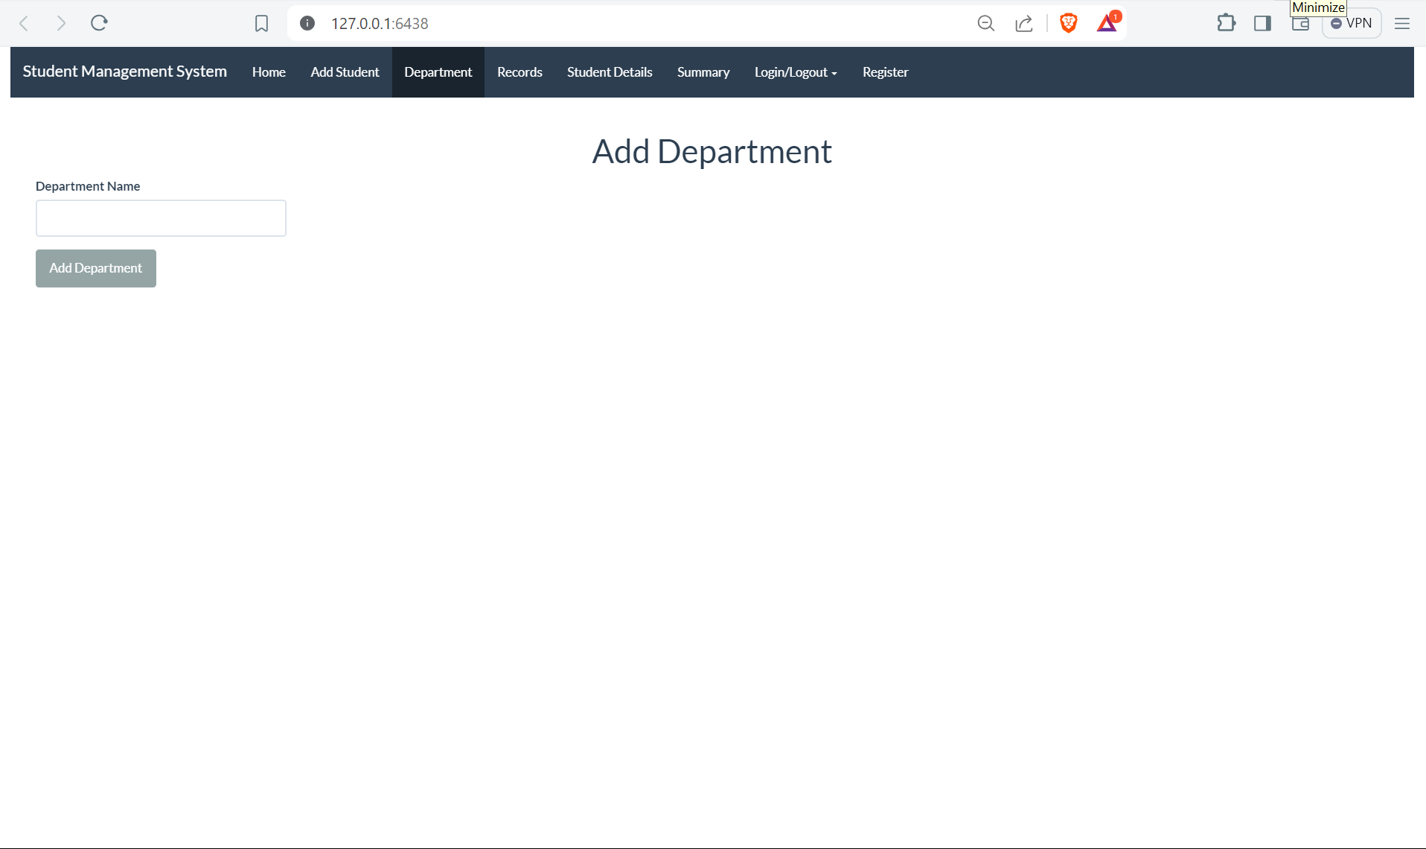
Core Library
Shiny
fluidPage()
navbarPage()
tabPanel()
actionButton()
Reactive Programming
reactiveVal()
observe()
observeEvent()
Server-Side Logic
shinyServer()

Slide 14
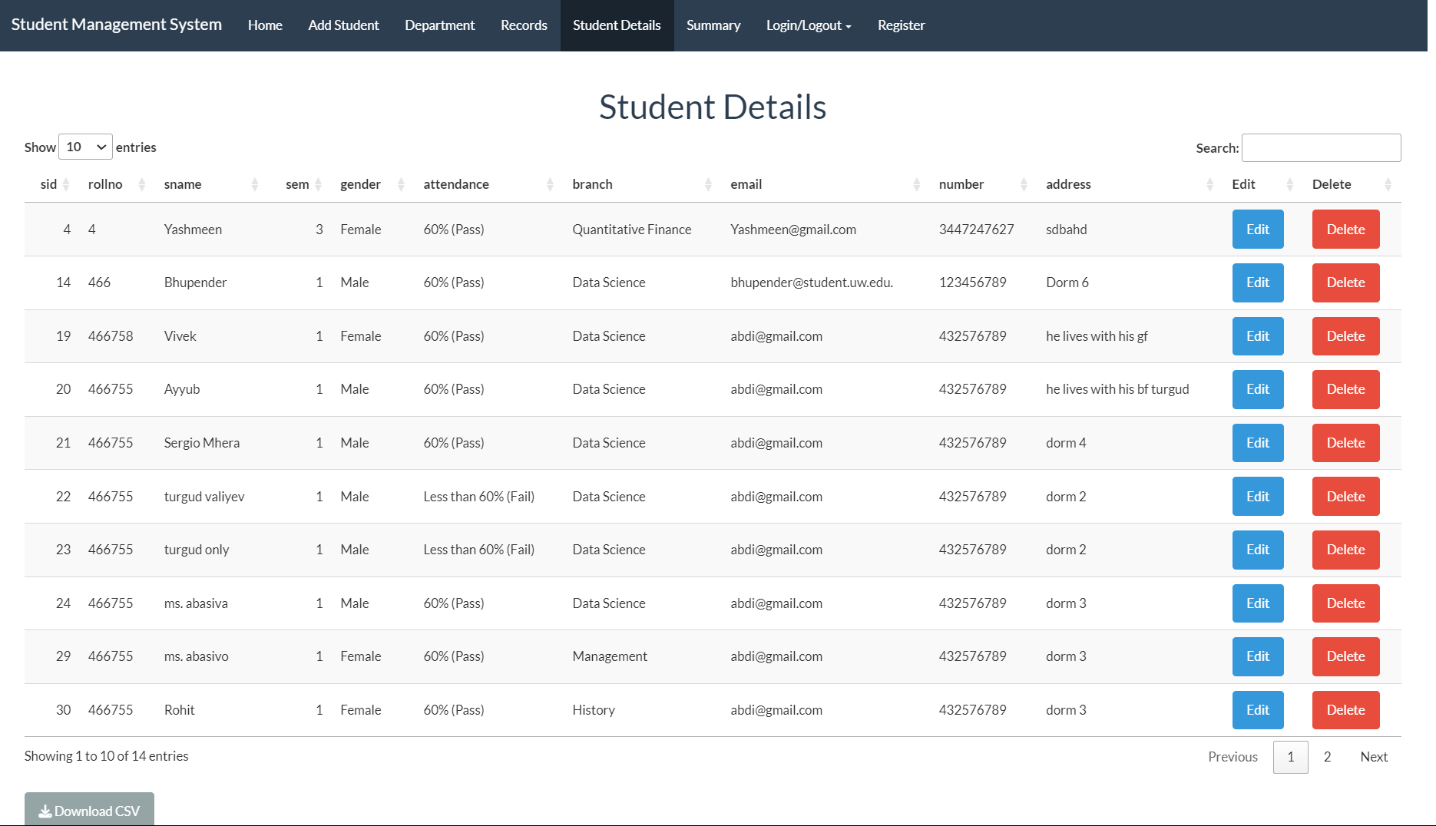

Slide 15
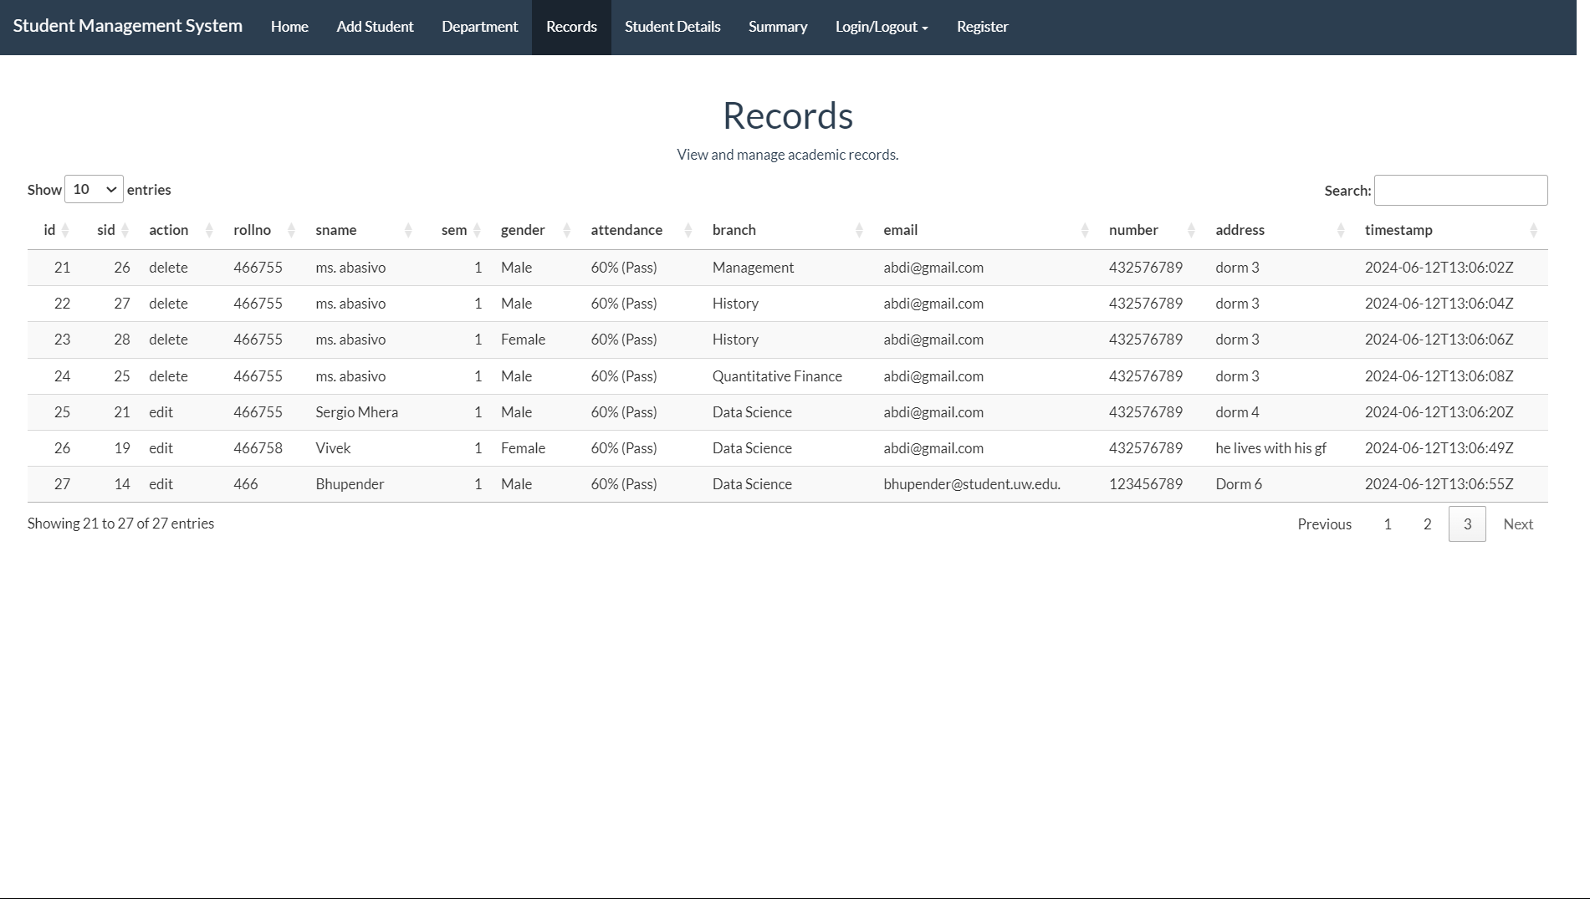

Slide 16
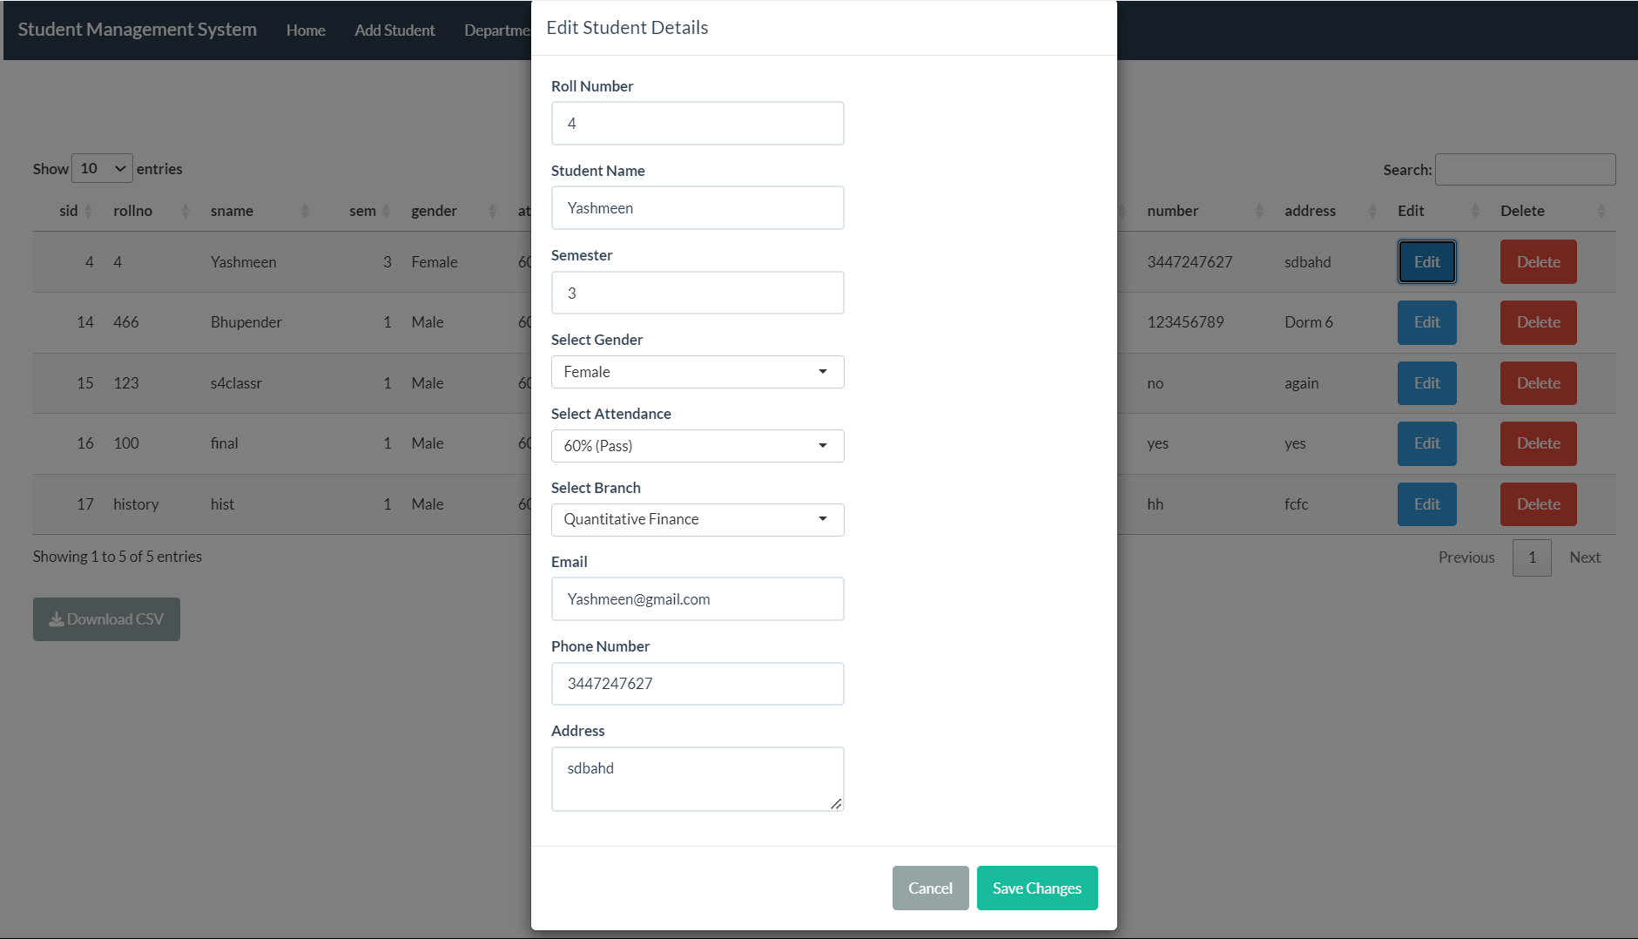

Slide 17
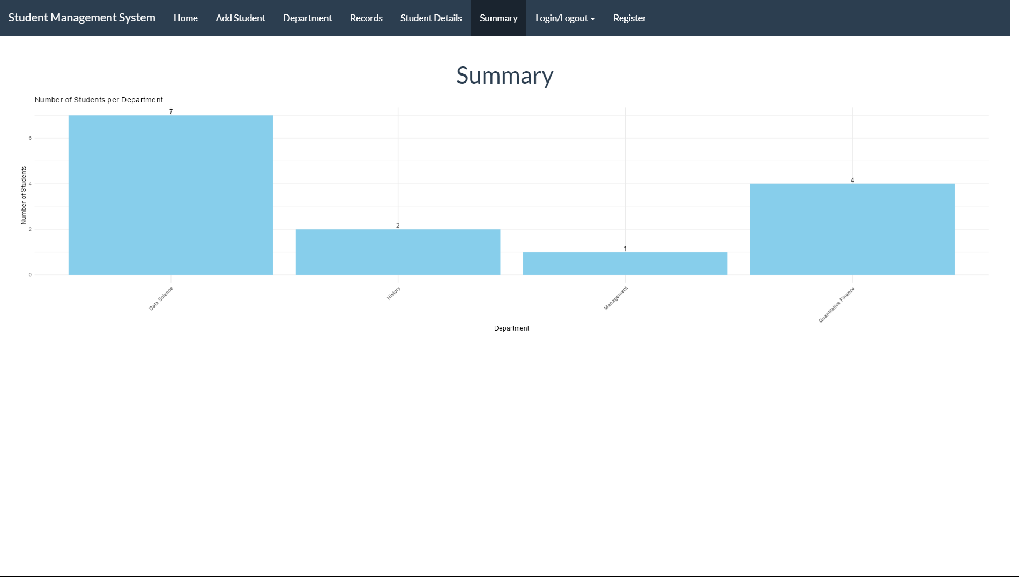

Slide 18

Thank you for your attention!

